Slide 1
Introduction to DISTRIBUTED SYSTEMS
Chapter 1

Slide 2
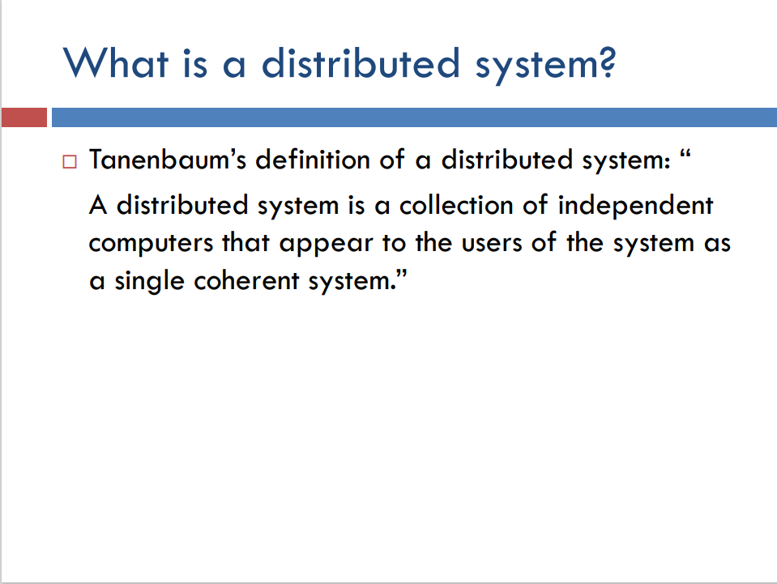

Slide 3
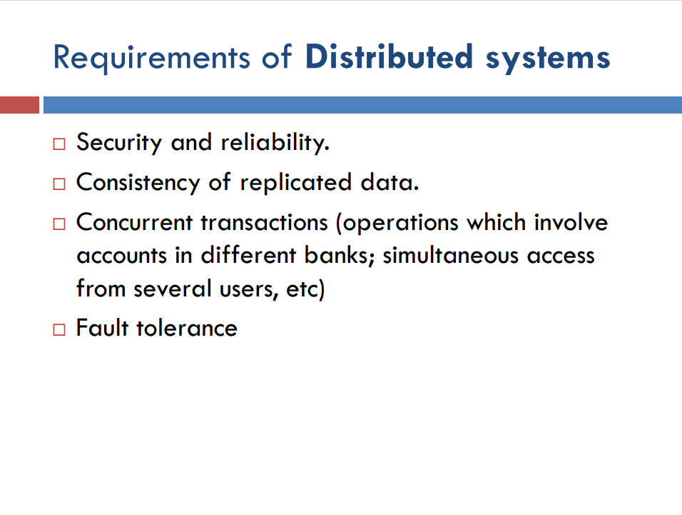

Slide 4
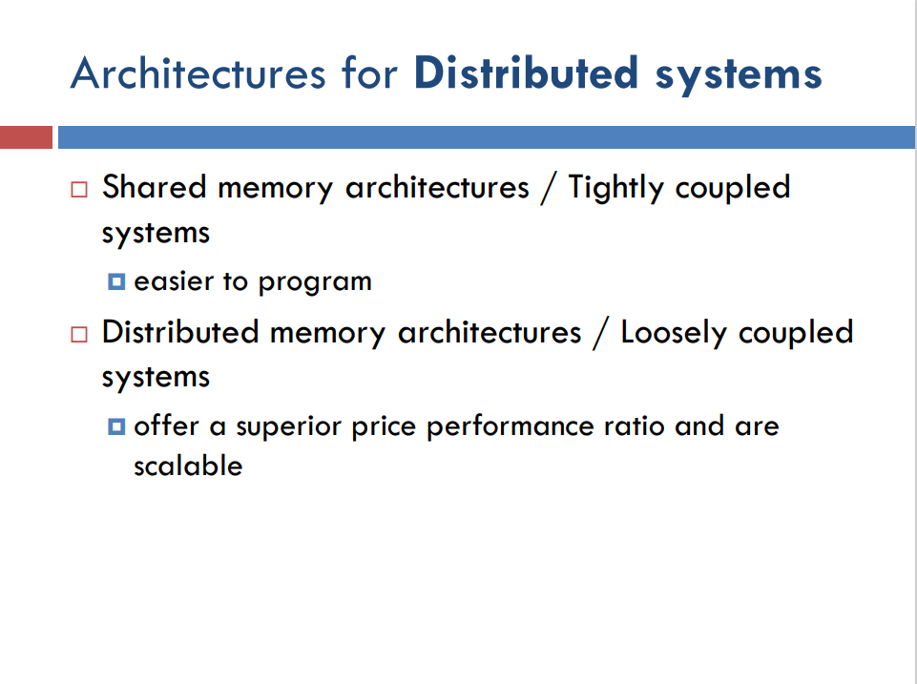

Slide 5
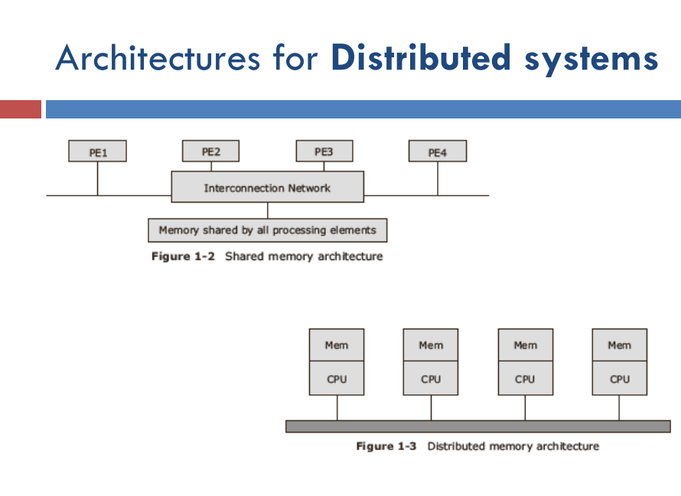

Slide 6
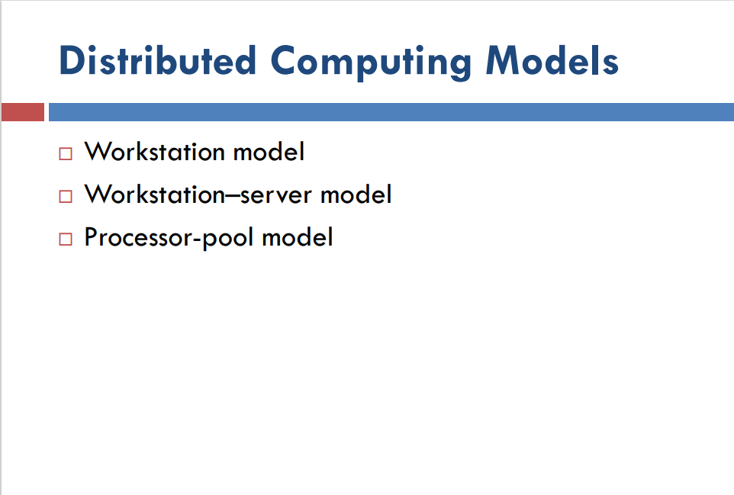

Slide 7
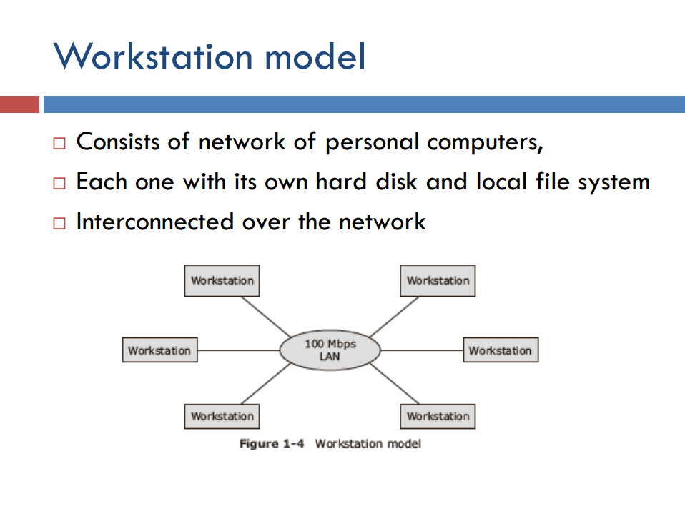

Slide 8
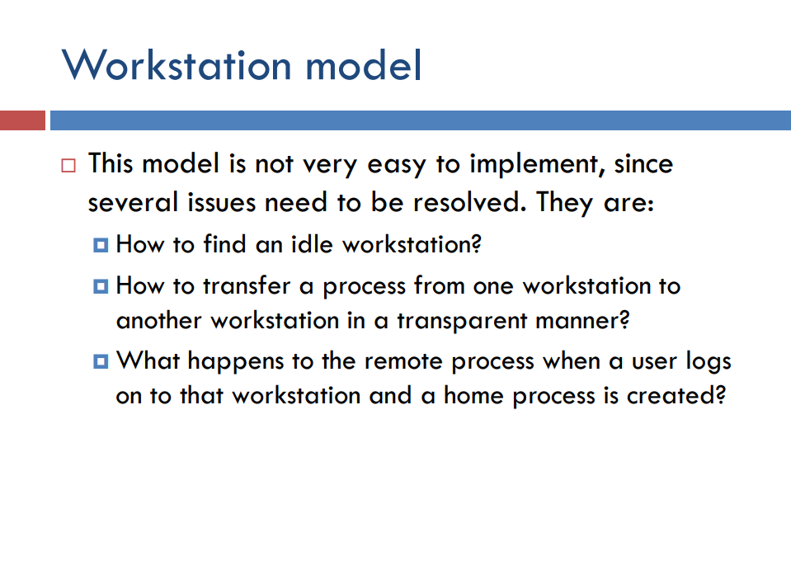

Slide 9
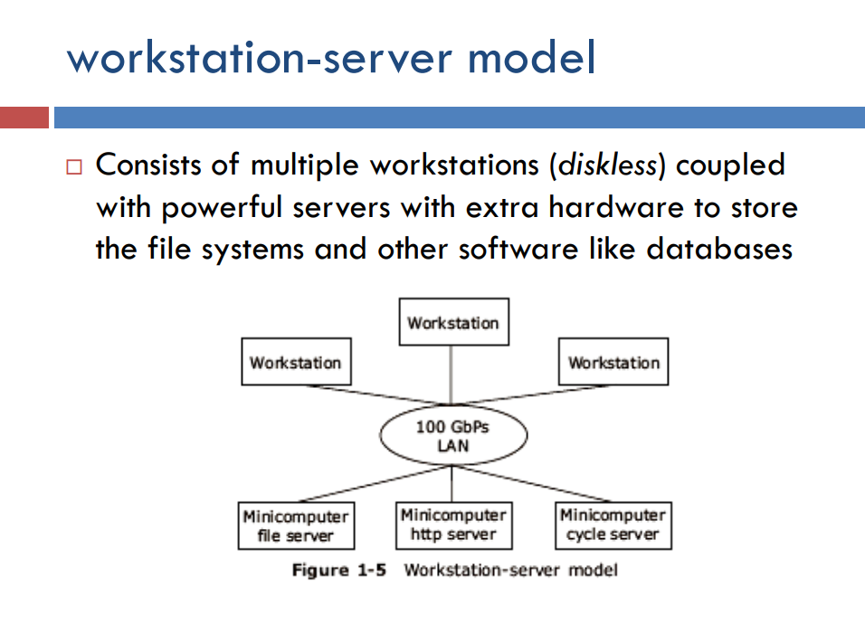

Slide 10
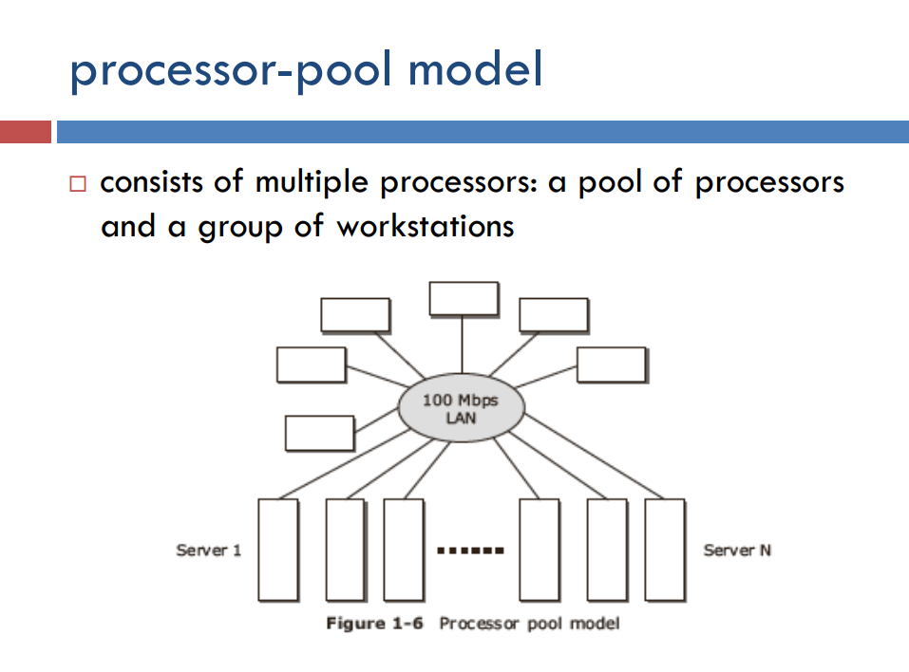

Slide 11
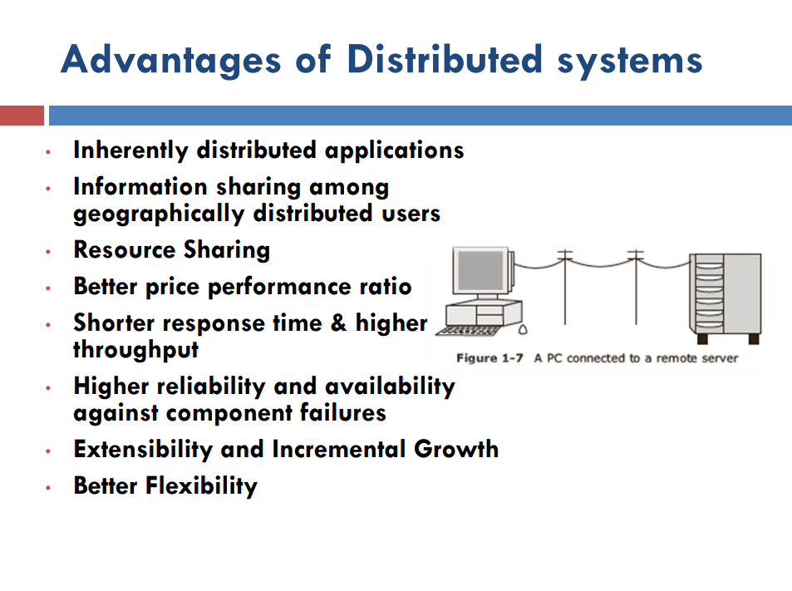

Slide 12
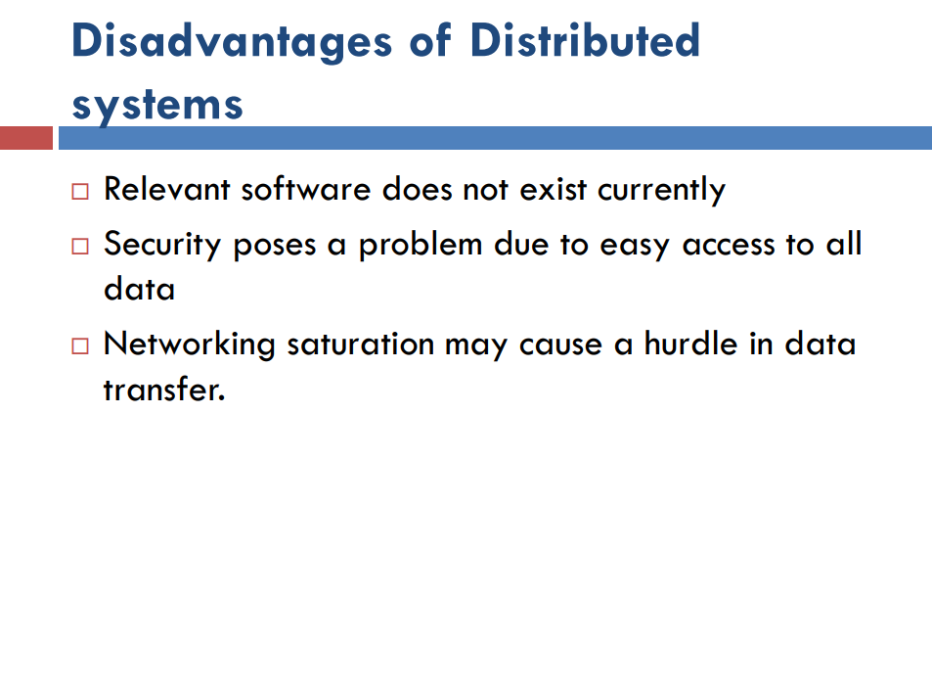

Slide 13
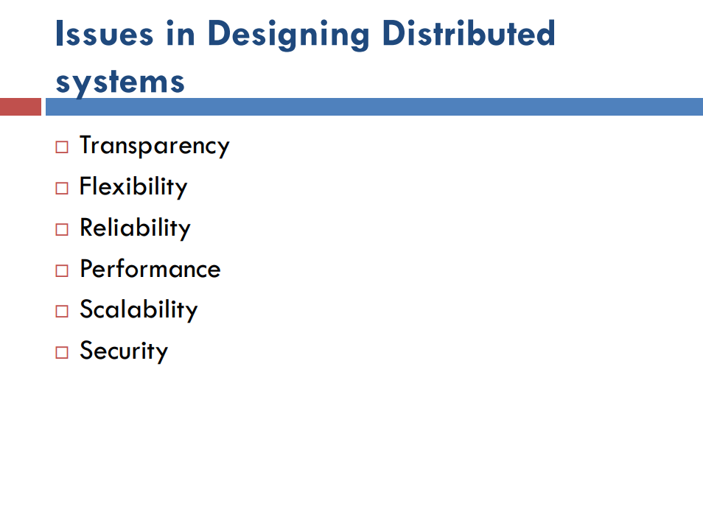

Slide 14
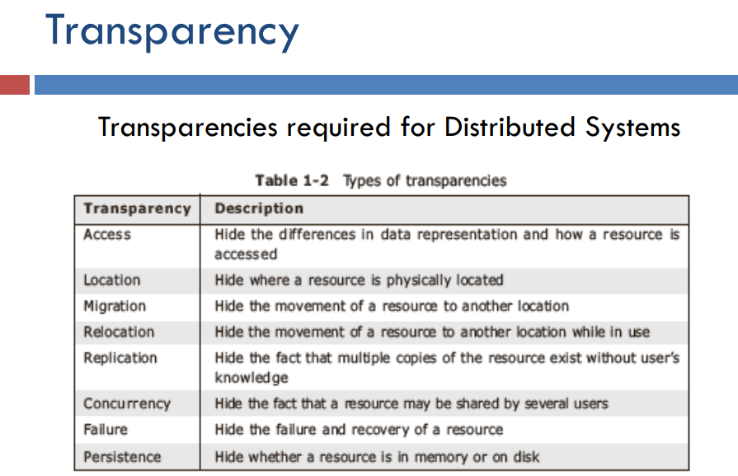

Slide 15
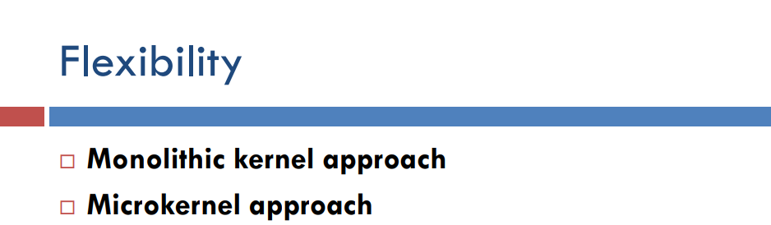
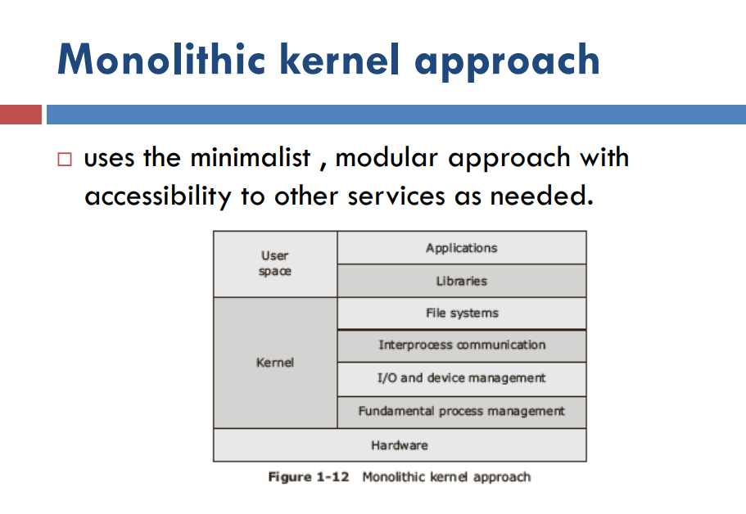

Slide 16
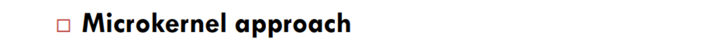
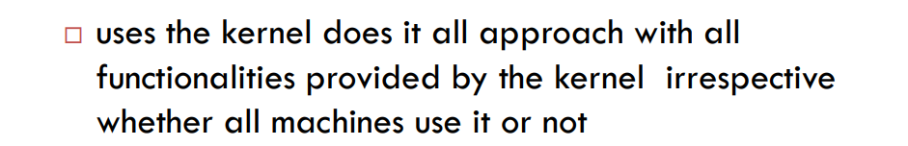


Slide 17
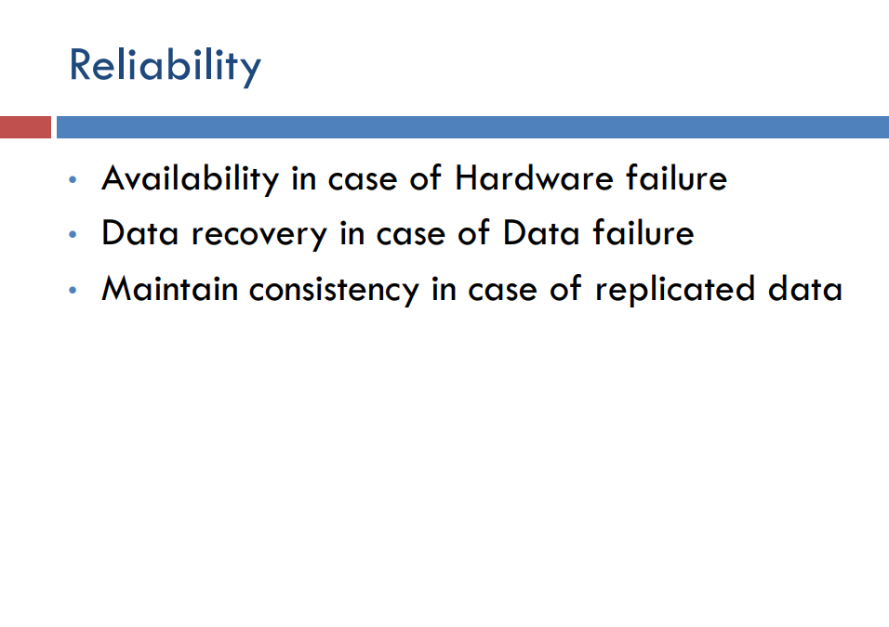

Slide 18
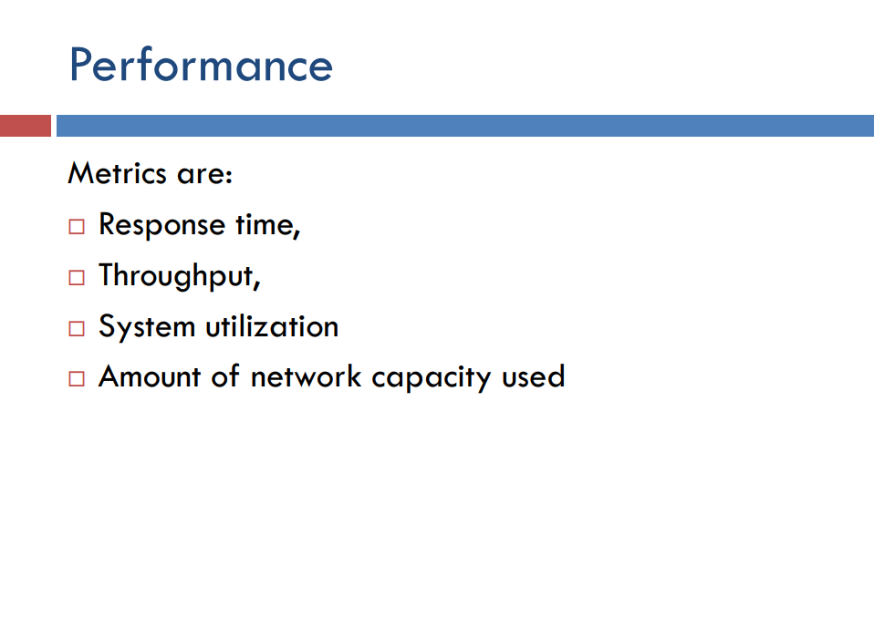

Slide 19
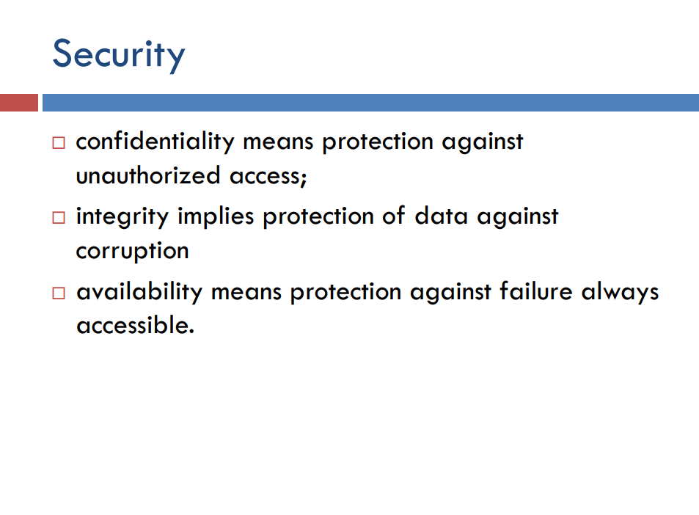

Slide 20
Software & Hardware concepts

Slide 21
Hardware concepts
Hardware in Distributed Systems can be organized in several different ways:
Shared Memory (Multiprocessors , which have a single address space).
Private Memory (Multicomputers, each CPU has a direct connection to its local memory).

Slide 22
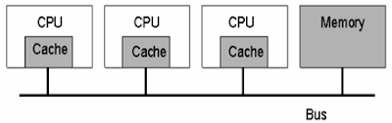
Multiprocessors
Multiprocessors – Bus Based
Have limited scalability
Cache Memory help avoid bus overloading.

Slide 23
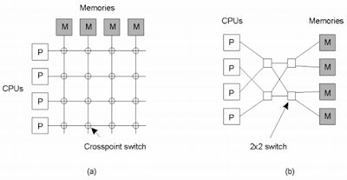
2. Multiprocessors – Switch Based
Different CPUs can access different memories simultaneously
The number of switches limits the number of CPUs that can access memory simultaneously
a) A crossbar switch
b) An omega switching network

Slide 24
Multicomputers
Homogeneous:
All CPUs and memory are identical;
Connected through a broadcast shared multi access network (like Ethernet) in bus based systems;
Messages routed through an interconnection network in switch-based multicomputer

Slide 25
2. Heterogeneous:
The most usual topology;
Computers may vary widely with respect to processor type, memory size, I/O bandwidth;
Connections are also diverse (a single multicomputer can simultaneously use LANs, Wide Area ATM, and frame relay networks);
Sophisticated software is needed to build applications due to the inherent heterogeneity.

Slide 26
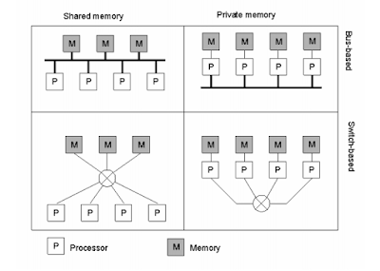

Slide 27
Software Concepts
Network operating system (NOS)
Distributed operating system (DOS)
Middleware

Slide 28
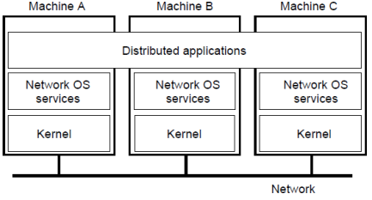
Network Operating System:
Each computer has its own operating system with networking facilities
Computers work independently.
Highly file oriented (basically, processors share only files)

Slide 29
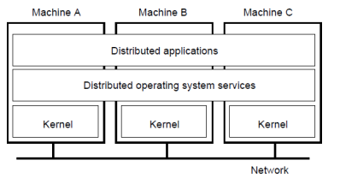
Distributed Operating System:
OS on each computer knows about the other computers
OS on different computers is generally the same
Services are generally (transparently) distributed across computers

Slide 30
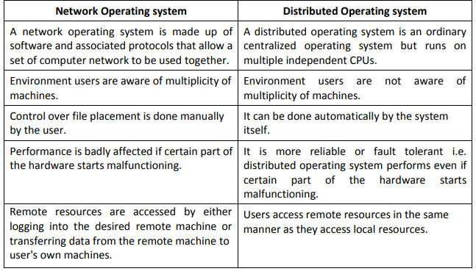
Network OS vs Distributed OS

Slide 31
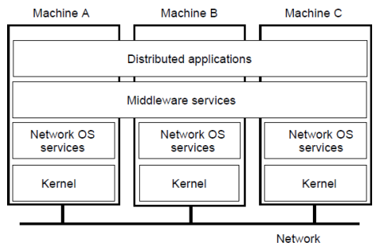
Middleware:
OS on each computer need not know about the other computers
OS on different computers need not generally be the same
Services are generally (transparently) distributed across computers

Slide 32
